Slide 1
GROUP 22
Lovely Digra IIT2017090
Abhishek Vishwakarma IIT2017091
Anuj Raj IIT2017092

Slide 2
Problem Statement
Our required aim is to design and analyse an optimal algorithm to find out all substrings with same character at the start and end in a given string .

Slide 3
Introduction
There are two sub parts of the problem which needs separate solution for faster execution.
> Counting such sub-strings
> Printing such sub-strings
And it is seen that the approach which is faster in counting
the sub-strings is slower in printing them. And the approach
which is faster in printing such sub-strings is slower in
counting the total occurences of such sub-string.

Slide 4
Algorithm
For the Counting each substring:
Simple(Naive) Approach :
> For this approach we will iterate two loops, where first loop variable(say i) goes from 0 to last character of the input string and the nested j loop goes from i+1 to last character of the input string.
> Now for each sub-string check if starting and ending character is equal or not.
> If it is equal update the counter.
> Finally at the end counter stores the count of total such sub-strings in the given input string.

Slide 5
Algorithm
Optimisation :
> The Key Idea is for any character (say 'a') total sub-strings starting and ending with 'a' is equal to n(n-1)/2 where, n is the frequency of 'a' in the input string.
> Generate a map of with distinct character as key and its frequency as its value.This is done with a single loop with O(L). L is length of input string.
> Now the total count summation of n(n-1)/2 (n is value, the frequency, of a character stored in the map) over all distinct chararcter in the Map.

Slide 6
Algorithm (For the Printing each sub-strings)
Using Map :
> Now, instead of storing frequency store the list of all positions of the character in the input string, in the Map.
> Now for a given character total sub-strings starting and ending with the same letter is sub-strings with all combination of these positions taken two at a time.
> For example, the list for letter 'A' is like A: 1-2-4. All sub-string starting and ending with 'A' will be: substring(1,2) substring(1,4) and substring(2,4).
> Now, we print all combinations for each distinct character and simultaneously increment the counter(for giving total count).

Slide 7
Algorithm (For the Printing each sub-strings)
Without using Map :
> For printing all character storing the list of positions in Map takes more space and extra time for its generation( O(L) ) where, L is the length of string.
> Printing can be implemented with same Brute force method discussed previously.
> If there is a match in the starting and ending letter increment the counter as well as print the sub-string.

Slide 8
Pseudo Code(For Counting Problem)
procedure subString(string Str, int a, int b)
len←String length
if b >= len then
b←len - 1
for all i = a to b do
//Store substring into S
return S
ctr←0
Str←input String
len←String length
for all i = 0 to len do
map generated storing character,frequency pair
for all it = map.begin() to EndOfMap do
ctr←ctr+ it(value)*((it(value))-1)/2
print(ctr)

Slide 9
Pseudo Code(For Printing Problem)
Str←Input string
len←Str.length()
for all i = 0 to len do
for all j = i + 1 to len do
if Str[i] == Str[j] then
print(Str.subStr(i,j-i+1))
ctr←ctr + 1

Slide 10
Experimental Analysis
For the experimental analysis of this algorithm, we will take lowercase string as an input and find it's length and plot a graph of length of string vs execution time.

Slide 11
Counting Problem (Brute Force)
For Brute Force approach for counting the no. of sub-strings with same character at the start and at the end from provided string
in every case nested loops run with complexity
(O(L(L-1)/2)) where,L is the length of the provided string .
The nature of the Time vs Length graph of Input String will be Quadratic.

Slide 12
Counting problem (Using Map)
In every case Map is created with complexity (O(L)), where L is the length of the input string.
If the input string all English Alphabet, then result is computed in (O(26)) in Worst Case. If the Input has only one distinct letter then the result is computed in (Ω(1)).
Worst case time complexity is (O(L) + O(26))
Space complexity is same , (O(26))
Best Case time Complexity is(Ω(1))
The nature of the graph Time vs Length of Input String will be Linear.

Slide 13
Printing problem (Without using Map)
In every case nested loops run with complexity O(L(L-1)/2).
Worst case will be when every letter in input string is Same. Thus adding the complexity of sub-string function call in every iteration with complexity O(L).
Best case is observed when none of the letter is repeated.
Worst case time complexity is bounded by O(L(L-1)2*L
Best Case time Complexity is Ω(L(l-1)/2)
where, L is the length of the provided string.
The nature of the graph Time vs Length of Input String will be Cubic.

Slide 14
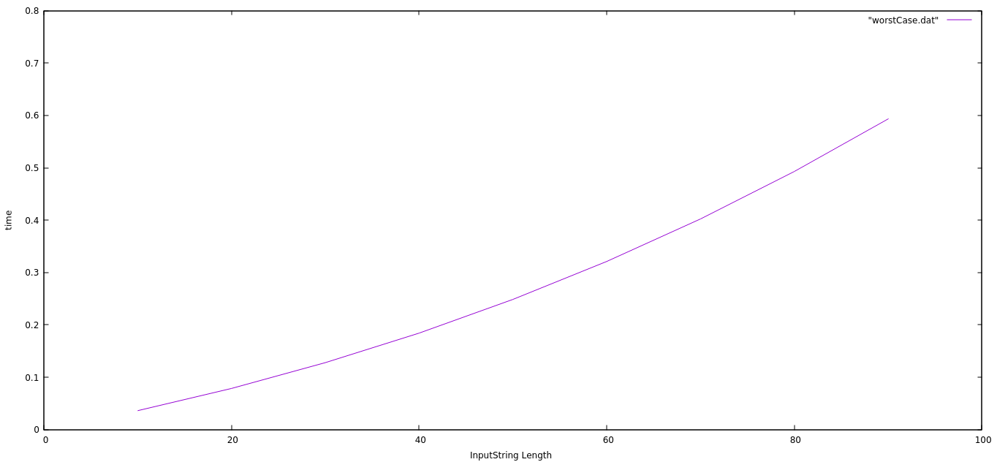
Counting problem (Brute Force)
Time vs Length of Input

Slide 15
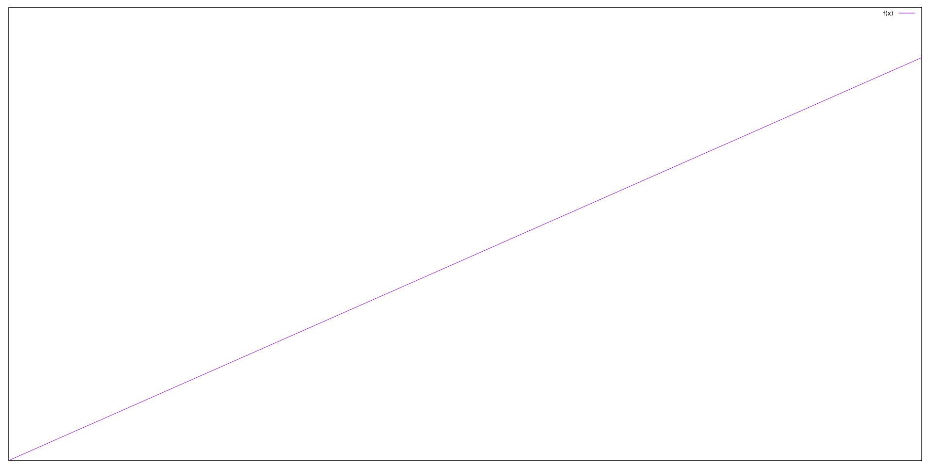
Counting problem (Using Map)
Time vs Length of Input

Slide 16
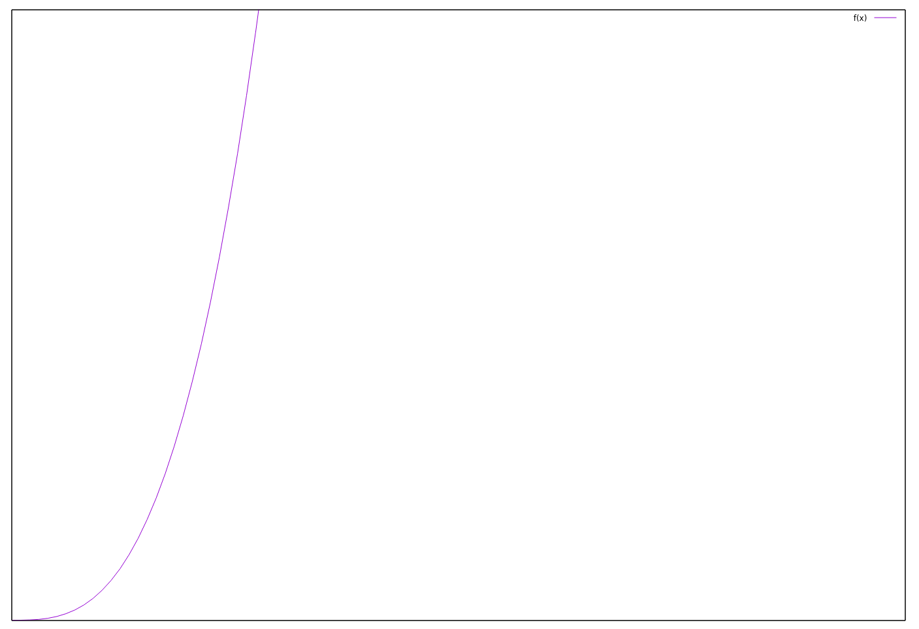
Printing problem (Without using Map)
Time vs Length of Input

Slide 17
Conclusion
The Algorithm is correct and optimal under the constraints defined in the Problem Statement.

Slide 18
Thank You!

